Slide 1
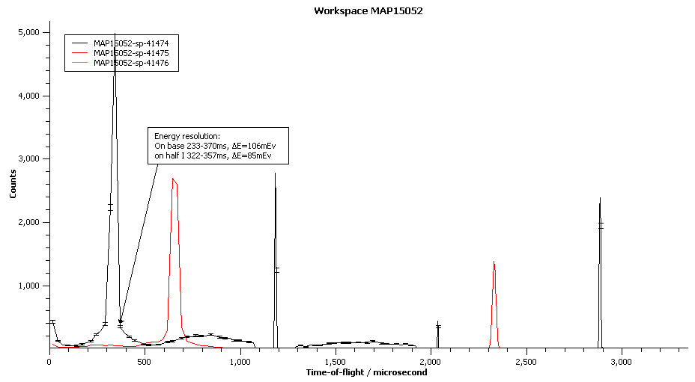
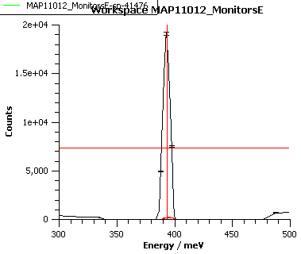
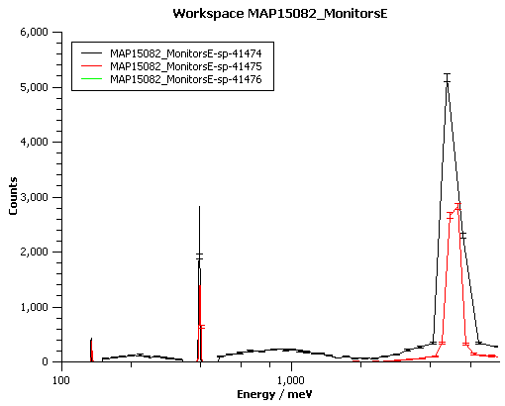
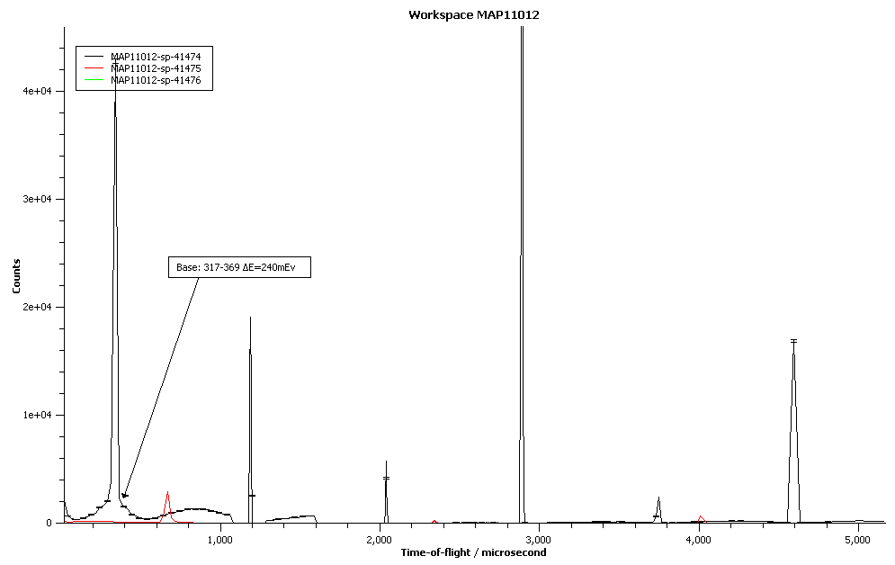
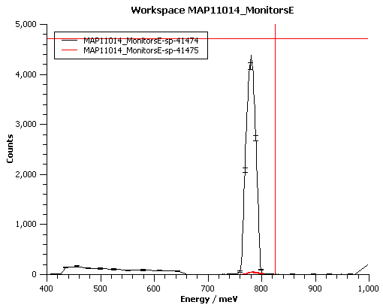
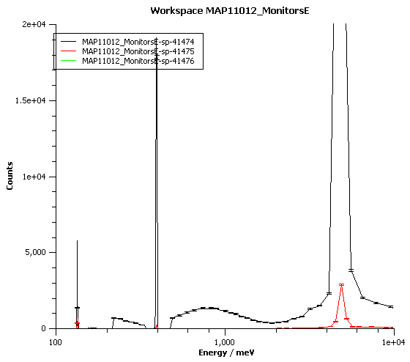
5000mEv
Ei=400meV, monitors
400meV
DE~10mEv=2.5%
Ei=787meV, monitors
ΔE~20mEv=2.5%

Slide 2
<1,0,0> (ΓH)
Ei=401,[1,y,0]
Ei=401,[x,y,0]
[150-160]
Ei=401,[1,y,0]
Ei=787,[x,y,0]
[150-160]
Ei=787,[1,y,0]
Ei=401,[x,y,0]
[110-120]
Ei=1371,[1,y,0]
Ei=401,[x,y,0]
[120-130]

Slide 3
Point N -- <1/2,1/2,0> = <1,1,0> in 3.096a^-1
Ei=787
1+x,1-y,0
Ei=1371
1+x,1-y
Ei=787
e=200
+50
Ei=1371
e=200
+50
Ei=787
e=250
+50
Ei=1371
e=250
+50
Ei=1371
e=300
+50
Ei=787
e=300
+50

Slide 4
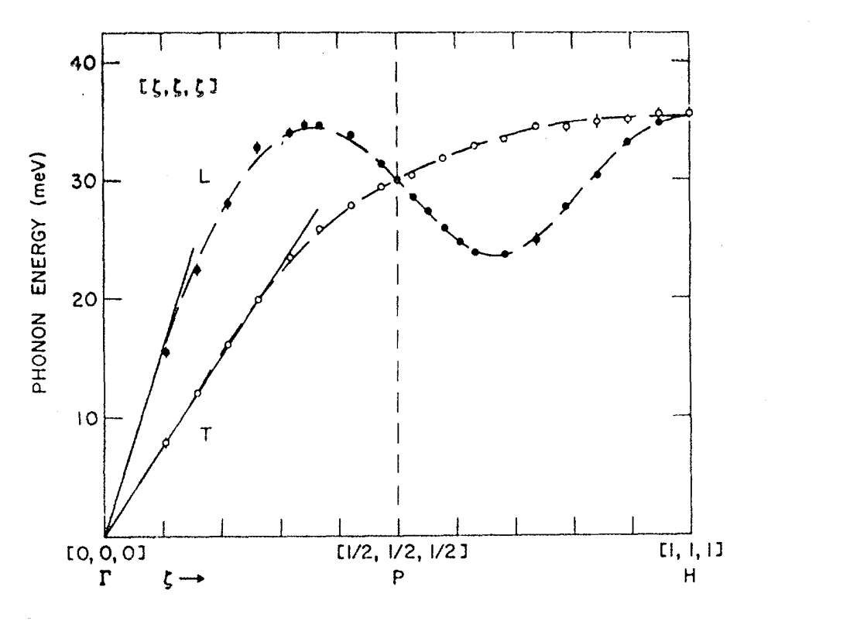
Phonons <111>

Slide 5


270
255

Slide 6
(1,0,0) (ΓΗ)
dE=I*exp(a*(y-b*x²)); I=0.2807 a=0.028 b=966
Ei=200meV
dE=80+10
I= 0.9933 a=0.031 b=873
Ei=400meV
I=0.1333 a= 0.0082 b=896.0894
I=0.3556 a=0.0082 b=905.1404

Slide 7
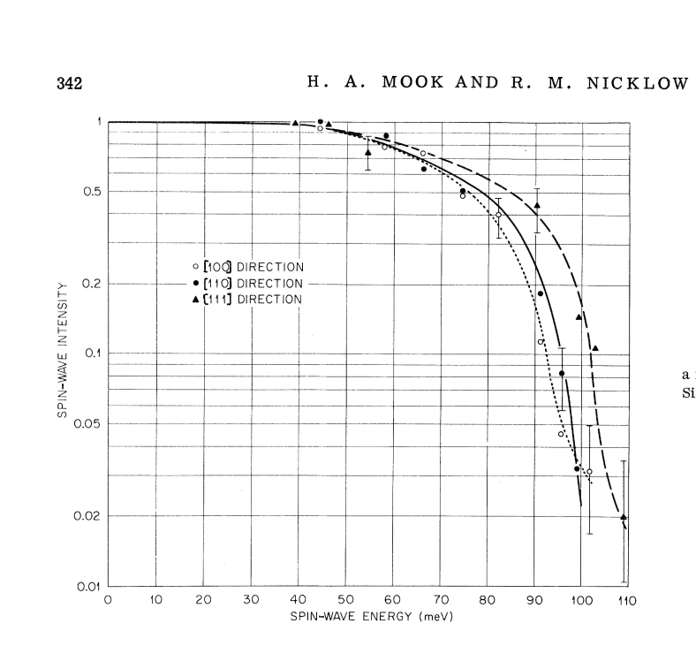
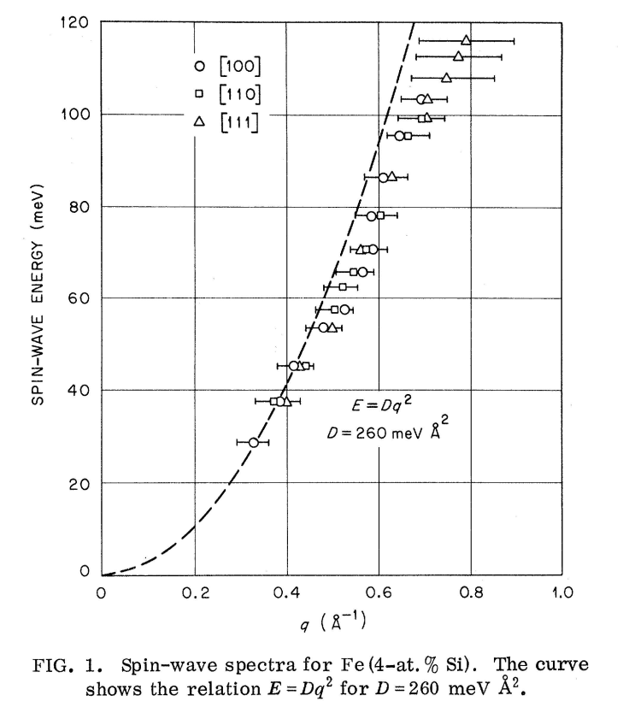
Parabola fit for cuts in all 3 100 directions around [1,1,0], E=D*q^2; D=204-224 meV*A^2
I_max=0.2322
D=202
Parabolic fit for cuts in 2 100 directions around [2,0,0], E=D*q^2; D=249,257 meV*A^2
D=222 mEv/A^2
I=0.079

Slide 8
Parabola fit for cuts in all 6 110 directions around [1,1,0],
E=D*q^2; D=194.43 meV*A^2
Ei=400 meV
Parabola fit for cuts in all 3 100 directions around [1,1,0], E=D*q^2; D=235 meV*A^2
I=0.16815
Parabola fit for cuts in all 3 100 directions around [2,0,0], E=D*q^2; D=185 meV*A^2 (185*sqrt(2)=261)
I=0.074

Slide 9
Are magnetic form-factor corrections correct?
[fw1,par1]=fit(w1_80a,@gauss_bkgd,[0.35,1.7,0.1,0.01,0.05],[1,1,1,1,1]);
par1 =p: [0.2564 1.7045 0.0843 0.0764 -0.0088] par1 = p: [0.2251 1.7174 0.0952 0.0928 -0.0185]
sig: [0.0379 0.0125 0.0119 0.0296 0.0228] sig: [0.0292 0.0119 0.0125 0.0358 0.0267]
par2 = p: [0.1026 2.2848 0.0626 0.0865 -0.0177] par2 = p: [0.1052 2.2822 0.0836 0.0651 -0.0071]
sig: [0.0368 0.0189 0.0170 0.0408 0.0158] sig: [0.0155 0.0107 0.0110 0.0308 0.0124]
fI = @(p)(p.p(1)*p.p(3)*sqrt(2*pi))
fI(par2)/fI(Par1)=0.2972; fI(par2)/fI(Par1)=0.41;
[I,mff]=fix_magnetic_ff([1.75,2.3],[1,1],[0,0,0,0]',[1,0,0],[2.1893,2.1893,2.1893])
Option 1: k=k0/4*pi mff(2)/mff(1)=0.368
[I,mff]=fix_magnetic_ff([1.7,2.35],[1,1],[0,0,0,0]',[1,0,0],[2.1893,2.1893,2.189])
1) 0.2995
fI(par2)/fI(par1)=0.361

Slide 10
cuts in 100 dir around [2,0,0] corrected magnetic FF
200mEv
400mEv
cuts in all 100 dir around [1,1,0], corrected magnetic FF
200mEv
400mEv

Slide 11
400mEv, [1,1,0], dE=4,dq=0.1
400mEv, [1,1,0], dE=4,dq=0.05
200mEv, [1,1,0], dE=2,dq=0.05
200mEv, [1,1,0], dE=3,dq=0.05
200mEv, [1,1,0], dE=4,dq=0.1

Slide 12
All corrections applied, small questions to curvature corrections base, errors wrong:
cuts in 100 dir around [2,0,0]
200mEv
400mEv
cuts in all 100 dir around [1,1,0]
200mEv
400mEv
cuts in all 100 around [1,-1,0]
cuts in all 110 around [1,1,0]
200mEv
200mEv

Slide 13
(1,0,0) (ΓΗ)
Ei=800, (2,0,0) I= 0.9933 a=0.0314 b=873
(1,1,0) I=0.1856 a=0.0032 b=886.8619
Ei=1371 (1,1,0) I=0.2869 a= 0.0059 b=1231

Slide 14
(1/2,1/2,0) (ΓΝ)
Intensity along spin wave line; Red line – cut [1,0,0]; blue line [1,1,0]
Weird:

Slide 15
(1/2,1/2,0) (ΓΝ)
(2,0,0) k->1/2,1/2,0; E=1373
x,y,0;dE=250+10
x,y,0;dE=290+10
(1,-1,0) k->1/2,1/2,0; E=1373
(1,1,0) k->1/2,-1/2,0; E=1373
(2,0,0) k->0,1/2,1/2,0; E=1373
(2,y,z) E=250+10
(1,y,z) E=200+20
Ei=787

Slide 16
(2,0,0), Ει=787
(2,y,z), E=200+20
(2,y,z), E=220+20
(2,y,z), E=240+20
(2,y,z), E=260+20
(2,y,z), E=280+20
(2,y,z), E=300+20

Slide 17
Need to check ->Problem: (1/2,1/2,0) (ΓΝ) E=1371
Ei=200+20, kx=1
Ei=220+20, kx=1
Ei=240+20, kx=1
The reason for increase
in intensity in this area

Slide 18
(1/2,1/2,1/2) (ΓΠ) – looks like the top of SW is below 300mEv

Slide 19
Ei=200, <100> [1,1,0]
Ei=200, <100> [2,0,0]
Ei=200, <100> [1,-1,0]
dE=5,dk=0.1
dE=10,dk=0.1
dE=5,dk=0.1
Ei=400, <100> [1,1,0]
Ei=400, <100> [2,0,0]
dk=0.2
dE=10
dE=20
dE=10
dk=0.2
Ei=800, <100> [2,0,0]
Ei=800, <100> [1,-1,0]
dE=40
dE=20
dE=10
Ei=400, <100> [1,1,0]
dE=10,dk=0.2 better ref points
dE=10,dk=0.1 better ref points

Slide 20
Ei=200, <100> [1,1,0]
Ei=200; <110> [1,1,0]
dE=15,dk=0.1
Ei=200, <110> [1,1,0], dk=0.1
Ei=200, <110> [1,-1,0]
dE=5
dE=10
dE=10
Ei=200, <110> [2,0,0]
Ei=400, <110> [1,1,0]
dE=10
dE=15, dk=0.15
dE=10, dk=0.1
Ei=400, <110> [2,0,0]
Ei=400, <110> [1,-1,0]
dE=15, dk=0.15
dE=10, dk=0.1

